Slide 1
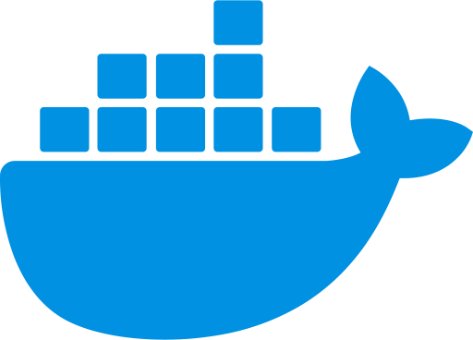
DOCKER
By David Gómez Junquer

Slide 2
CONTENTS
Here’s a simple list of what im going to explain about docker.
What is docker?
Why is it the most used?
Advantages and Disadvantages.
Simple demostration.
Conclussion.

Slide 3
1
WHAT IS
DOCKER?

Slide 4
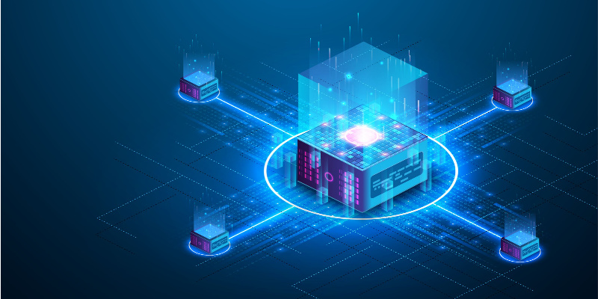
WHAT IS DOCKER?
Open – Source
Application deployments
Containers
Images
Subnetworks

Slide 5
2
WHY IS IT
THE MOST USED?

Slide 6
WHY IS THE MOST USED?
PORTABILITY
EFFICIENCY
SCALABILITY
Containers are enviroment-independent.
The same application will always run the same way
Containers share the host Kernel.
Lighter and Faster than VM
Easy to manage applications at any scale.
(Developement, Testing, Production, etc..)

Slide 7
3
ADVANTAGES
AND DISADVANTAGES

Slide 8
ADVANTAGES AND DISADVANTAGES
PORTABLE
EFFICIENT
DEPLOYMENT
SECURITY
LEARN. CURVE
ATTENTION
ADVANTAGES
Same application, different enviroment.
Lightweigh and Fast
Quick and Easy deployment
Sharing kernel can pose security risks
There might be an initial learning curve
Require constant attention to avoid issues
DISADVANTAGES

Slide 9
4
SIMPLE
DEMOSTRATION

Slide 10
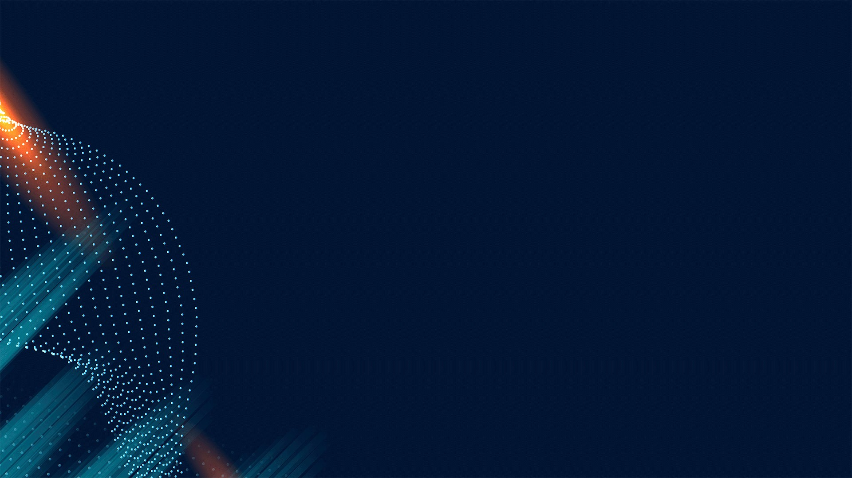
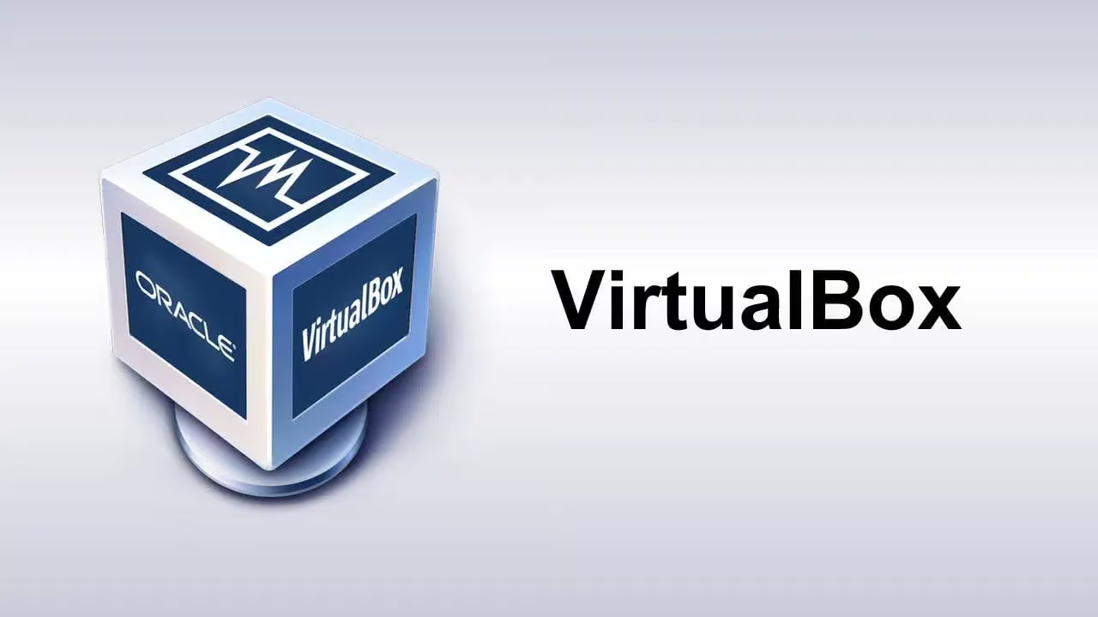
VIRTUALBOX
Creates one kernel for each V.M
Each V.M has its own O.S
High level isolation
Requires medium – high harware

Slide 11
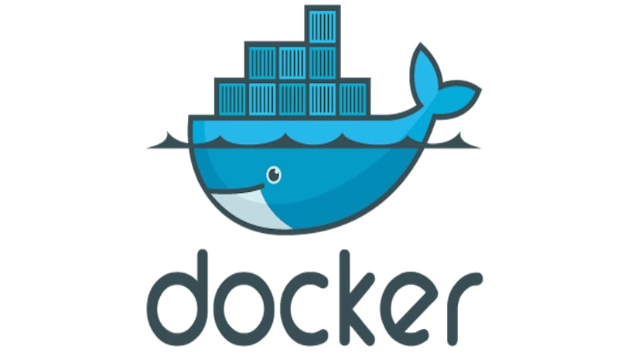
DOCKER
Shares the host kernel
Each container has it’s basic O.S
Easy container installation
Has a public repository:
DOCKER HUB

Slide 12
5
CONCLUSSION

Slide 13
CONCLUSSION
POSITIVE
NEGATIVE
DOCKER
CAN BE USED ON LOW HARDWARE
NEEDS MORE KNOWLEDGE
V.M.
VERY NICE ISOLATON
NEEDS MEDIUM-HIGH HARDWARE

Slide 14
THANKS FOR YOUR ATTENTION
I hope you liked it and learned something more about docker

